Slide 1

E-Governance Of USA
By:-Samip Gnyawali

Slide 2
General Overview
The United States was one of the first countries in the world that in fact initiated and implemented the concept of e-government by making the first tentative
steps in the early 1990s to reform the entire system of public administration through the use of new technologies.
Today this nation is a globally recognized leader in this sphere.
It should be noted that the first initiatives to develop the national strategy in applying information technologies in public administration began to be discussed in the United States back in the early 1970s both in academia and public agencies at various levels. However, the discussions were theoretical in nature, and the ambitious ideas were rarely implemented in conditions of traditional, and somewhat bureaucratic public administration structures.

Slide 3
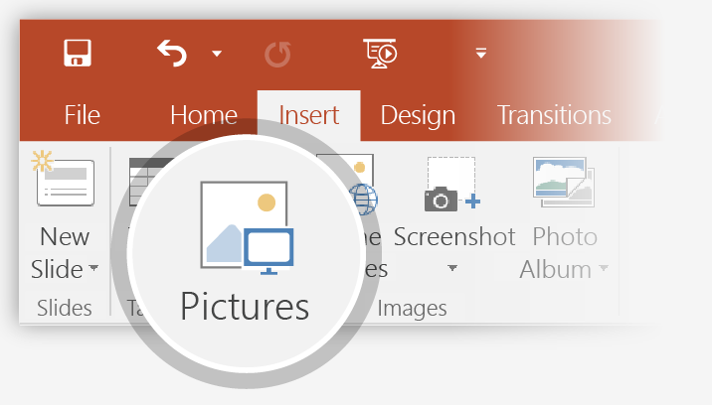
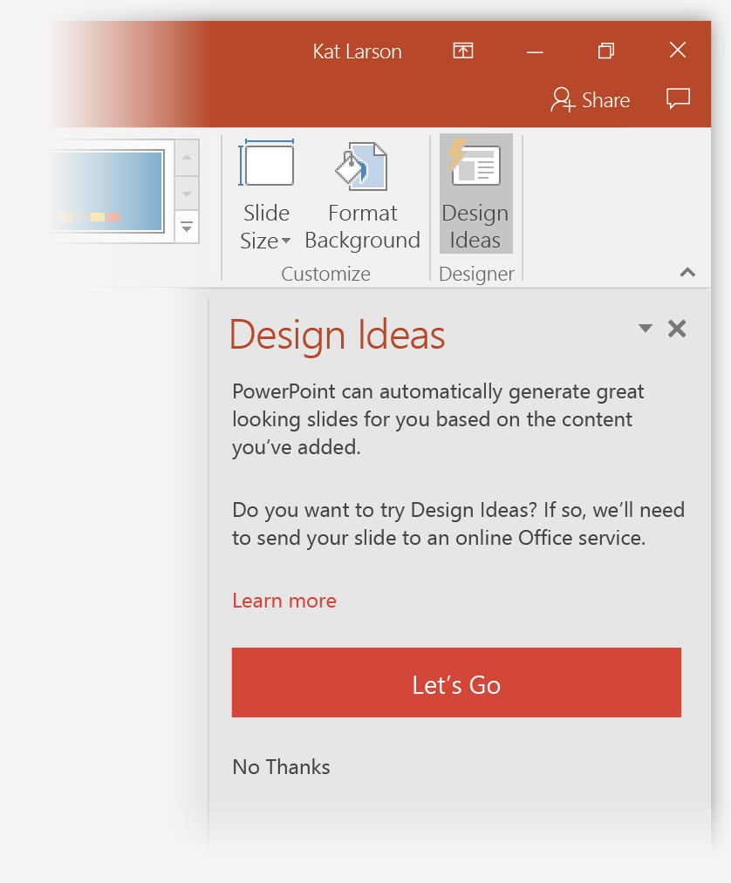
E-governance Status Of USA Till 2009
he election of Barack Obama as President of the United States became associated with the effective use of Internet technologies during his campaign and in the implementation of his new administration in 2009.^{[147][148][149]} On January 21, 2009, the President signed one of his first memorandums – the Memorandum for the Heads of Executive Departments and Agencies on Transparency and Open Government.^{[150]} The memo called for an unprecedented level of openness in government, asking agencies to "ensure the public trust and establish a system of transparency, public participation, and collaboration."^{[150]} The memo further "directs the Chief Technology Officer, in coordination with the Director of the Office of Management and Budget (OMB) and the Administrator of General Services (GSA), to coordinate the development by appropriate executive departments and agencies [and] to take specific actions implementing the principles set forth in the memorandum."^{[150]}
President Obama's memorandum centered around the idea of increasing transparency throughout various different federal departments and agencies. By enabling public websites like recovery.gov and data.gov to distribute more information to the American population, the administration believes that it will gain greater citizen participation.^{[151]}
In 2009 the U.S. federal government launched Data.gov to make more government data available to the public. With data from Data.Gov, the public can build apps, websites, and mashups. Although "Gov 2.0", as a concept and as a term, had been in existence since the mid-2000s, it was the launch of Data.gov that made it "go viral".

Slide 4
Stages In Egovernance In Usa
Stage – 1 (Emerging): An online presence is established through official website. Information is basic, static and limited.
Stage – 2 (Enhanced): Government sites increase content, become more dynamic. The content is updated more frequently.
Stage – 3 (Interactive): Users can interact with department through a set of forms, and email.
Stage – 4 (Transactional): Users can actually avail government services by making payment on website.
Stage – 5 (Seamless): There is full integration of e-services across administrative and departmental boundaries.

